Slide 1
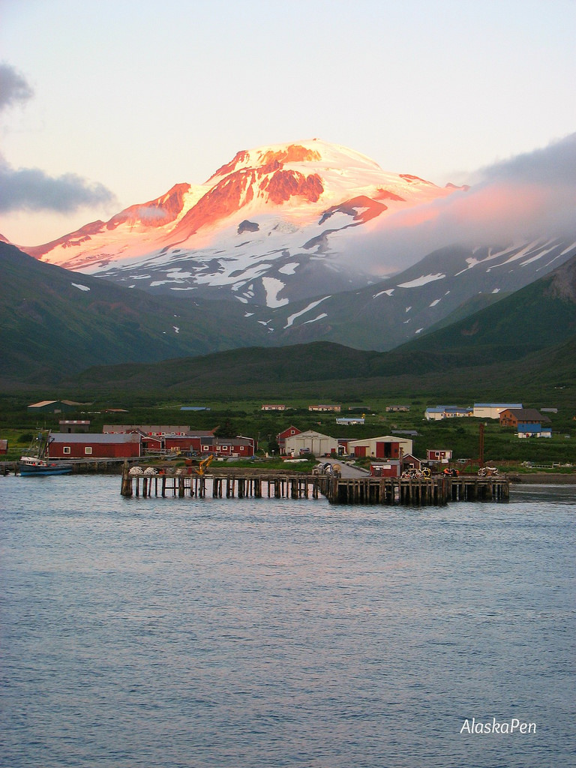
False Pass
Vision Navigation Strategic Planning Presentation

Slide 2
Introduction
Presenter: Mayor Hoblet

Slide 3
General Community Demographics
Population
58
Number of households
14
Industries
Commercial Fishing
Processing
1 plant now with another being built
General Infrastructure overview
Well used and well maintained
General community condition overview
Steady, potential growth from new processor

Slide 4
Community Health Factors
Communication and Connectivity
Transportation
Housing
Employment
Environmental Hazards
Health System
Public Safety
Community Characteristics

Slide 5
Communication and Connectivity
Phone
Land line
Cell service through GCI
Internet/television
GCI internet at businesses
Few private residents have internet
Dish network- TV
Mail
Scheduled 3X per week
Radio
Looking at rebroadcasting Sand Point signal

Slide 6
Transportation
Local
Gravel roads in generally good repair (5miles)
Air
Grant 3X per week
Private charter
Marine
Alaska Marine Highway every 2weeks (April-September)

Slide 7
Housing
Age
Hud housing from late 70’s and early 80’s
Availability
None
2 B&B’s usually always full
General Description/overview
Land available for residential units
Housing stock is generally older but in good repair (though needs continuous weatherization upgrades)

Slide 8
Economy & Employment
Employment Rate
90%
Everyone who wants to work has a job
Employment Climate
Plenty of work not enough workers
Support for new processing capacity
Overview/description
Economy and employment is steady with expected growth from new plant
500 seasonal employees
New small/large businesses
New Silver Bay Seafoods Plant

Slide 9
Environmental Hazards
List known hazards
Volcanos
Earthquakes
Tsunamis
Flooding
Processing plant failures (ammonia, fire)
Describe actions taken
Tsunami siren
SCERP in place
Describe potential needs/unwanted outcomes
Old Peter Plant derelict buildings and contaminate land (fuel spill)

Slide 10
Health System
Access to medical transportation
Commercial
Private charter
Coast Guard
Available auxiliary care
X-ray
Limited lab
Telemedicine
Clinic Y/N- Yes
Clinic Quality
Good quality, staffed by Health Aid

Slide 11
Public Safety
General public safety description
Generally a safe community
VPSO
General overview of service
Service is adequate for community needs
General description of community needs
Seasonally could use more help

Slide 12
Community Characteristics
Access to food, goods, services
Community store
Barge every two weeks
Activities and events
Local agencies sponsor events
Community potlucks
New recreation and library director
Full time vs seasonal resident counts
58 full time
500 seasonal
Civic participation (voters, engagement in local government, etc.)
Majority of community participate in voting
Hard to get people to engage on local government
School K-12
7 students ( 3 under 5 in the community)
Working to recruit families from processors
Why did kids move in or out
More opportunies

Slide 13
Top Assets of False Pass
Transportation and marine assets (infrastructure)
Landfill and gravel (construction resources)
Renewable energy potential
Strong financial position
Community strengths (culture, family friendly)
Political influence
Public safety
Community infrastructure (buildings, water supply, store with large storage capability)
Opportunity for tourism

Slide 14
Top Threats to False Pass
Natural disasters
Fishing regulations
Alcohol and drug abuse
Challenged logistics and connectivity
Increasing cost of living and lack of housing
Decreasing population and school enrollment
Brain Drain
Aging infrastructure (deferred maintenance)
Access to advanced healthcare

Slide 15
Priority Goals
Strategic Initiatives Led by False Pass:
Keeping the School Open
Water system upgrade
Harbor house
Housing/Population/Employment are interconnected
Notes:
Community led goals as well as community vision
Legislative advocacy needs identified

Slide 16
Questions?

