Slide 1
Aleutians East Borough
Vision Navigation Presentation
December 2020

Slide 2
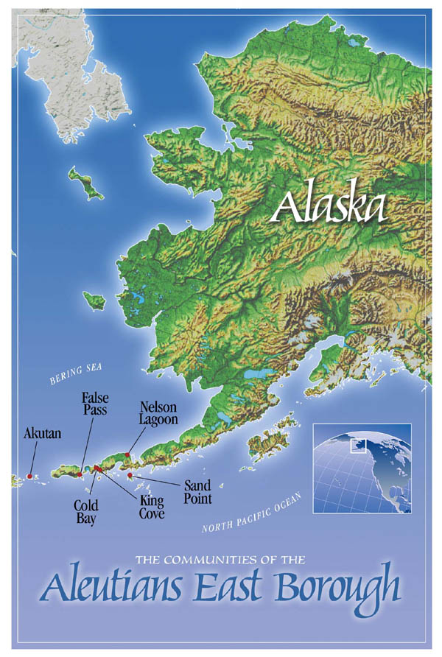
Vision Navigation Overview
Planning = to formulate a program for accomplishment
Strategic = that which is essential to be effective
Vision Navigation = Partnering to plan and execute the results that are vital to the organization

Slide 3
Components
Establish the Vision: Determine the Purpose, Products, Values, Lessons and Vision that drive and define AEB
Strategic Assessment: Analyze strategic environment and select initiatives to grow AEB
Internal Assessment: Analyze the organization for opportunities to strengthen it and solve problems

Slide 4
Component 1: Establish the Vision
Purpose: AEB’s reason for being, why it exists
Values: Beliefs or rules for business
Vision and Vivid Description: clear compelling description of where we want to be
Products/Services: Results wanted by external customers
Lessons from History: experience that is instructive to our future

Slide 5
To ensure the standard of living, well-being & future of our communities
Purpose of Aleutians East Borough

Slide 6
AEB Values
Honest: To the people we represent
Open/Transparent: More is better
Integrity: Striving to improve the trust of residents, being ethical
Being Productive: Follow through with what we start
Resourceful: Sharing the strengths of our communities

Slide 7
Healthy People, Healthy Schools, Healthy Communities
Diversification of industry including our natural resources & community flexibility for borough stability
Healthy people with a strong cultural identity
Our schools & community are providing quality education including secondary education & vocational skills within the communities
Planned infrastructure projects completed
Availability, utilization & development of connectivity (physical & electronic)
Vision

Slide 8
Services
Title 29 – Taxation, funding education, planning
Financial support to school district
Financial support to EAT (Health)
Operation/maintenance/construction of school facilities
Funding, construction, operations, and repair of intra-borough transportation
Assistance to municipalities for funding of capital projects
Planning and zoning for Borough lands
Advocacy for fisheries that supports socio economic development through policy and research (Fisheries)
Regional transportation and land management plan (Comprehensive Plan)
Support for subsistence activities
Support for quality of life within our communities

Slide 9
Lessons Added for 2022
Be adaptable – plans should be able to change – Adaptability is critical to success
Keeping White Papers on major projects as a living history document
Our role and our leadership in fisheries is important. The Borough needs to remain a leader
Our leadership does not need to be frontline – we can show leadership by facilitating others and taking the role of follower
We need to shift expectations and recognize what can actually be accomplished in one year cycle
Prioritize

Slide 10
Component 2: Strategic Assessment
Analyze strategic environment
and select initiatives
to grow AEB

Slide 11
Strategic Projects
Projects chosen to grow and expand AEB

Slide 12
Initiatives Recently Completed
2018:
Youth Advisory on AEB Assembly
Budget Request Process
Borough Asset Management
Nelson Lagoon School Renovations
Office Technology & Connectivity
2019
False Pass Harbor House Design
2019 Continued
Borough Property Surveys
OSHA requirement Compliance
2021
Nelson Lagoon Dock
Employee Handbook
Akutan Harbor – Land Ownership
Cold Bay Terminal Improvements
Financial Policies and Procedures

Slide 13
On-going Initiative
This project is currently on-going, but will not be detailed in the new strategic plan:
Transportation - King Cove & Cold Bay Road Airport Access (2019)

Slide 14
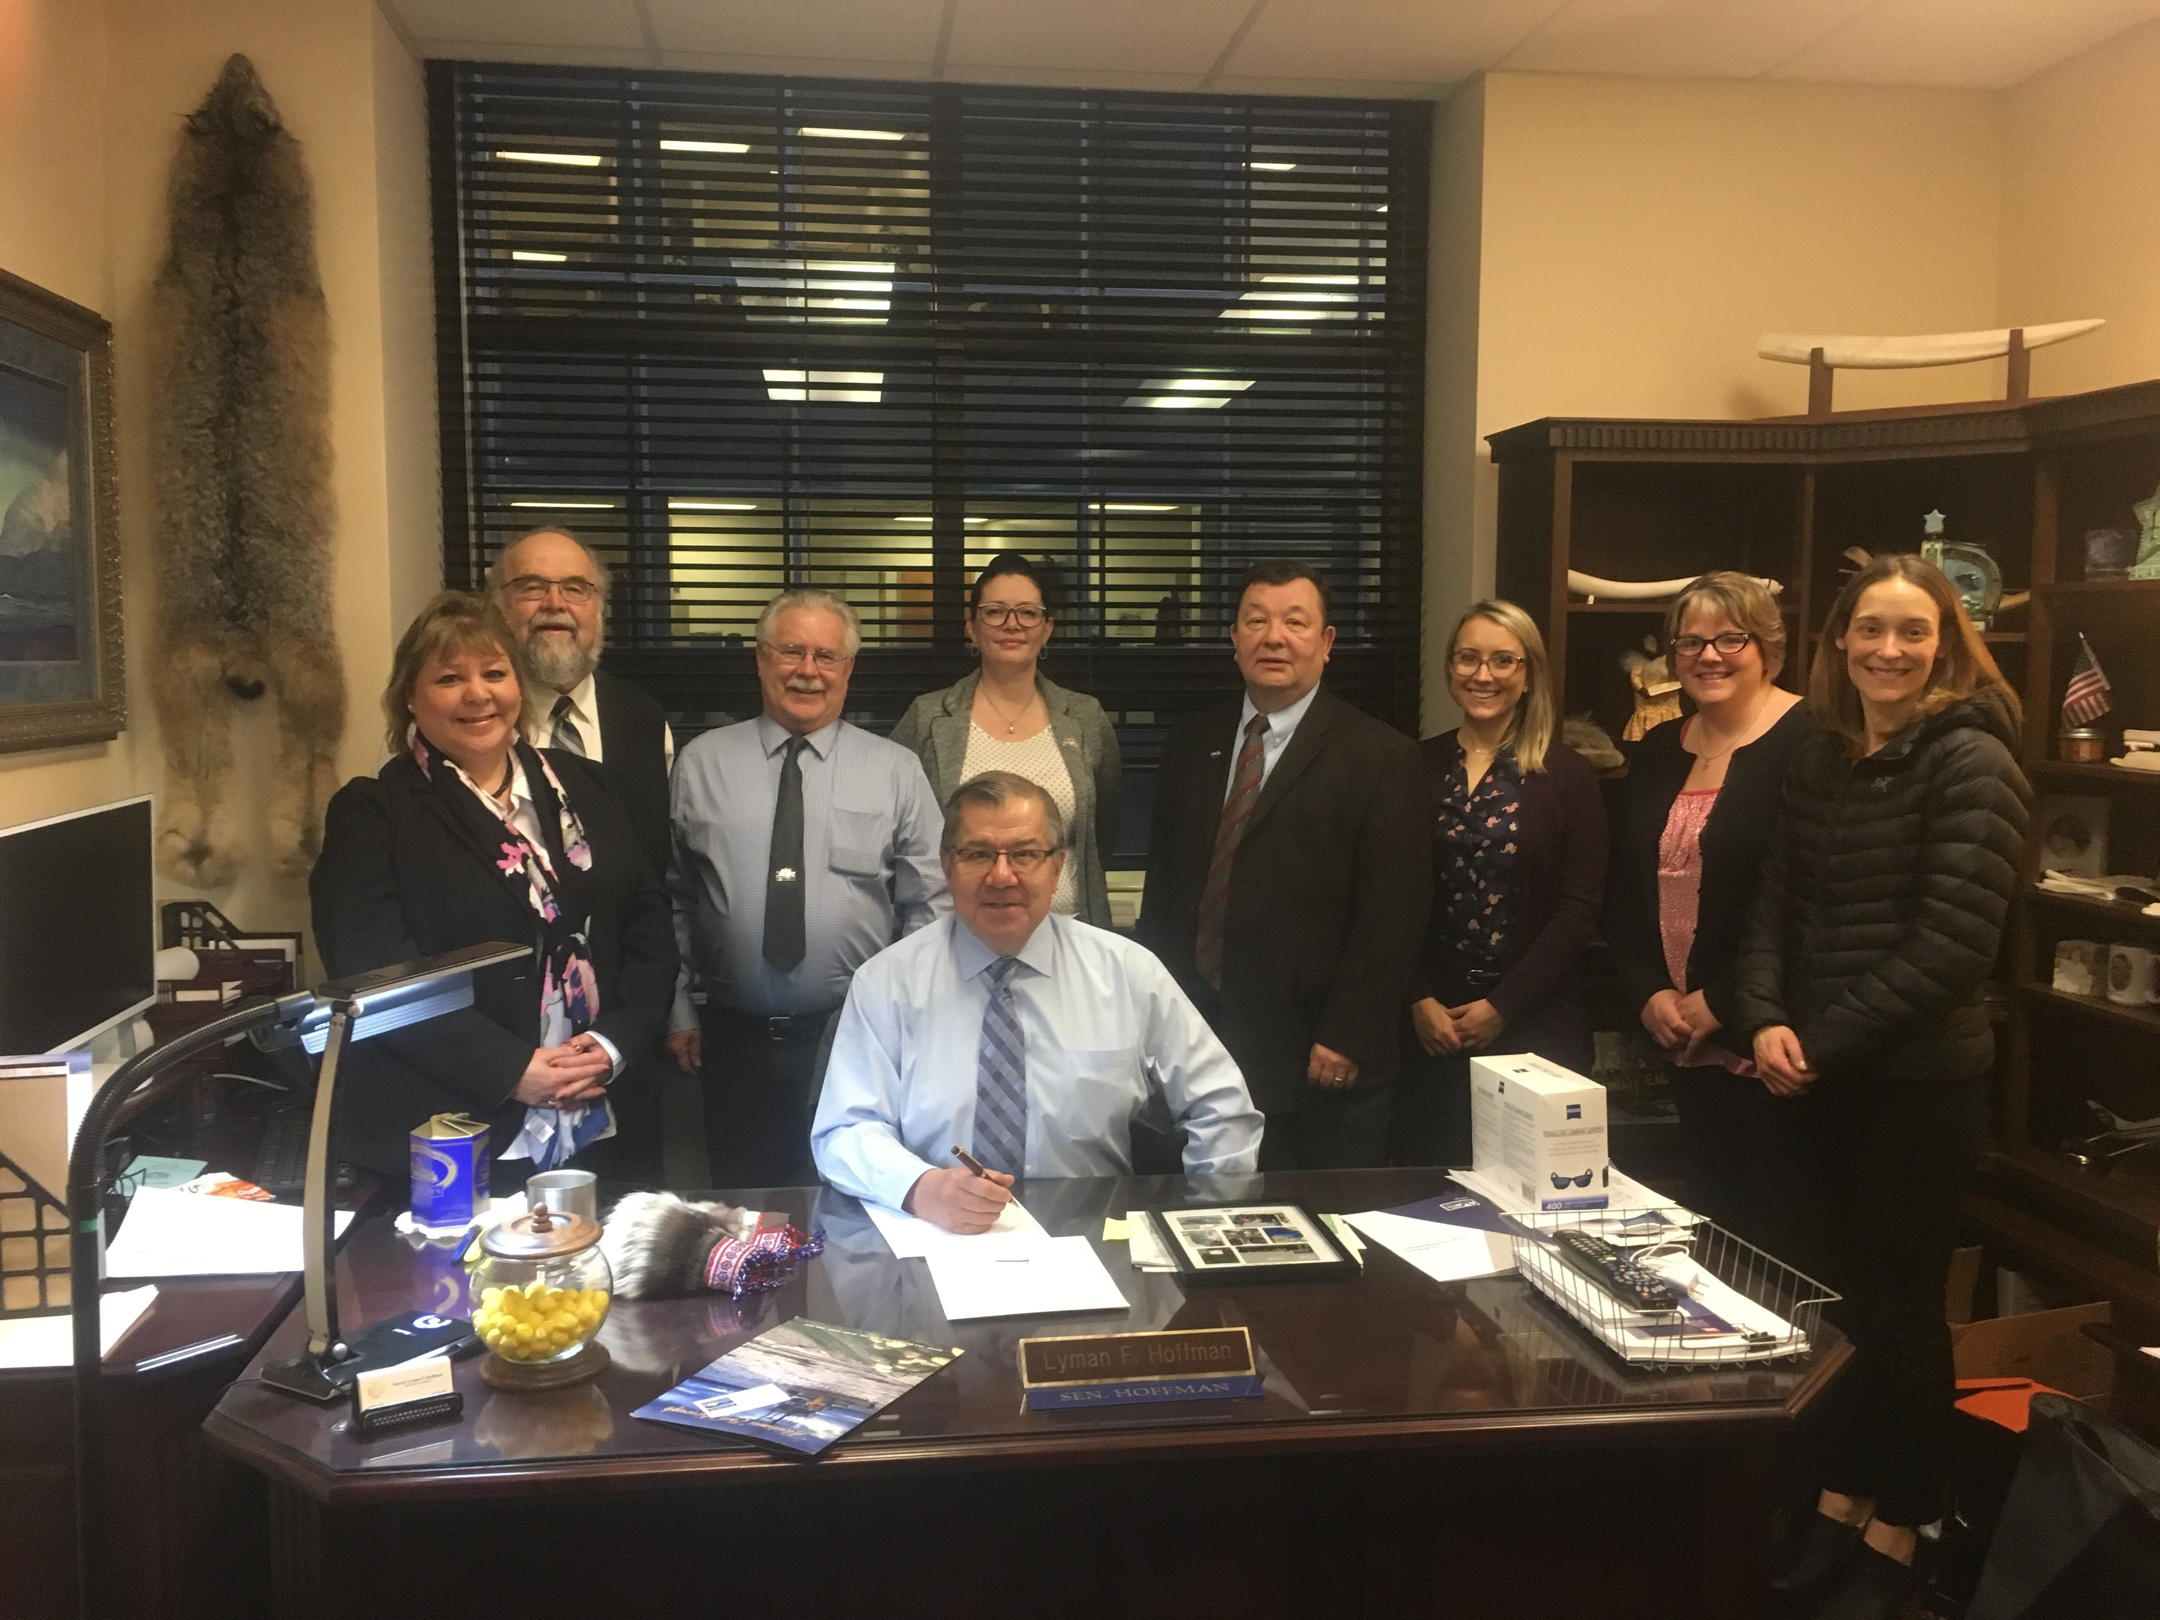
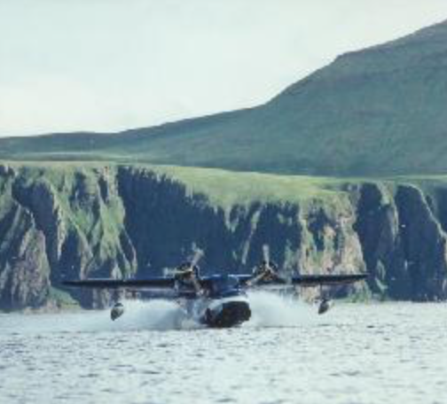
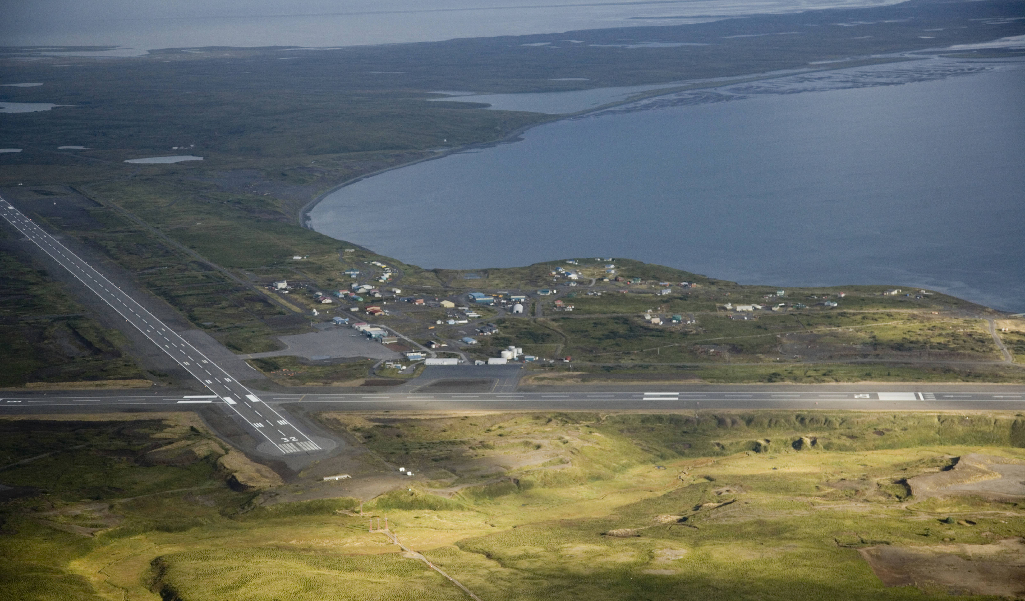
New Strategic Initiatives
The following pages outline the strategic initiatives for 2022

Slide 15
Strategic Initiative A.1: Fisheries Advocacy
Description:
Strengthen fisheries expertise, advocacy, public outreach, and education within the Borough
Project Lead: Ernie
One-year Target: Maintain and protect existing fisheries
Multi-year Goal: Protect and strengthen our existing fisheries

Slide 16
Why is the Initiative important?
We don’t have an overarching fisheries organization that people can relate to.
Fisheries is how we exist as a borough; it is the primary economic driver of all the communities and is the source of the AEB and communities’ livelihoods.
When income sources leave, communities shut down.
Fisheries advocacy includes diversification of natural resources. When we get better at fisheries advocacy, we gain skills that help us support new developments.
Permits are leaving Alaska rapidly. People who own the permits live outside and fish over the season but don’t remain in the community (resources leave the community).

Slide 17
Why is the Initiative important?
Fisheries regulations are necessary, and it is critical we know how to navigate regulations.
Ground fish quotas are diminishing, and some fisheries are being rationalized.
Federal and state funding for surveys is diminishing resulting in more restrictive management.
COVID pandemic is further diminishing fisheries via both fishermen and processors.
COVID is reducing surveys which negatively impact stock assessments.
The environment is changing causing changes in our fisheries.

Slide 18
What does the Initiative include?
Help communities reestablish new and/or strengthen existing advisory committees.
Anticipate needs and prepare responses to fisheries management limitations, emergency orders and actions.
Advocate for borough friendly positions on policy boards.
Continue to advocate for surveys.
Serve as facilitator in lieu of a traditional fisheries organization.
Maintaining existing fisheries infrastructure (e.g. processors).
Provide guidance and training to community to encourage participation in BOF advocacy.
Borough climate change policy in the context of fisheries and its impact on our fisheries.

Slide 19
Recent Accomplishments
Advocacy to NPFMC re BSAI trawl cod program.
Limits offshore processing, keeps more processing onshore.
Sideboard's/limits participation in open access WGOA cod fisheries.
Advocacy to Board of Fish: Facilitated comments opposing ACR’s 6 & 7.
Participated in the groundfish plan team process to set allocations.
Met with fisherman, processors, communities, other partners to address common goals re AEB fisheries.

Slide 20
What does the Initiative include?
New for 2022
Increase BOF facetime.
Chum issues and response plan.

Slide 21
Strategic Initiative A.2: Fisheries Research
Description:
Strengthen fisheries expertise, public outreach, advocacy, and education within the Borough. Research that supports the management of local commercial fisheries.
Project Lead: Charlotte
One-year Target: Complete genetic & tagging study on western gulf pacific cod
Multi-year Goal: To have a supplemental survey in the western gulf for ground fish

Slide 22
Why is the Initiative important?
Supporting fisheries research reduces uncertainty in stock assessments and supports realistic quotas.
Our region is underrepresented in surveys.
We need to set a precedent that we can complete this research with the assistance of local people decreasing the cost of research and improving accuracy.

Slide 23
Recent Accomplishments
Cod Tagging:
March 2021 field work successfully completed; 25 satellite tags, 957 conventional tags, 155 biological samples.
To date, the majority of the satellite tagged fish were recovered in the Bering Sea.
Partial funding secured for continued 2022 work.
Survey Project: original concept not feasible; other methods being explored.
Other Research:
EM: $1,486,051 in grant funding across 3 projects; restructuring of pelagic pollock trawl fishery to remove observers from vessels and implement salmon census.
Data Portal: data ownership for fisherman; real-time salmon bycatch hotspot mapping.

Slide 24
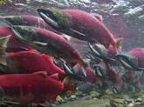
What does the Initiative include?
Secure additional funding for research projects.
Continue partnerships with local individuals and agencies.

Slide 25
Strategic Initiative A.3: Board of Fish
Description:
Preparation for BOF proposals
Project Lead: Ernie
One-year Target: Respond to Agenda Change Request
Multi-year Goal: Protect & strengthen our existing fisheries including two major BOF meetings

Slide 26
Why is the Initiative important?
The Board of fish added issue will increase our workload substantially.
BOF makeup has changed dramatically over last year.
BOF has changed in board makeup and may need additional outreach/education about Area M.
With both Area M and Chignik submitting disaster requests we need to prepare for potential opposition?
We have 2 critical BOF meetings during this plan time period.
Opportunity for AEB to voice opinions/position.

Slide 27
Recent Accomplishments
Preparations for March 2022 Board of Fish meeting.
Meetings with fisherman, partners, potential consultants, Board members.
Securing needed funding for an unexpected Board of Fish year.
Preparing documents- white papers, memos, and letters.

Slide 28
What does the Initiative include?
Prepare white paper/brochure to present to BOF members individually.
Working with Advisory Committees and individual fishermen on advocacy issues to:
Outreach to BOF members
Act as a resource for developing BOF proposals
Anticipate losses and prepare for negotiations
Prepare chum background documents.

Slide 29
Strategic Initiative B: Diversification of Natural Resources
Description:
Identifying and capitalizing on existing resources in the region to grow our economy.
Project Lead: Charlotte
One-year Target: Construct a Kelp Pilot farm & identify another potential mariculture revenue stream
Multi-year Goal: Continue to explore alternative uses and industries for our natural resources. Identify a minimum of one alternative natural resource option in the borough.

Slide 30
Why is the Initiative important?
We need to diversify our resource base.
Fisheries are volatile and we need to respond by identifying alternative industries.
We have abundant natural resources that are under utilized.
Our people are ready to work, looking for opportunities to be industrious.
Diversification includes a number of activities such as: energy, mariculture, etc.

Slide 31
Recent Accomplishments
DNR/ADFG and USACE permitting completed for Zachary Bay pilot farm.
NFWF FIF grant finalized.
National Sea Grant project initiated.
Started initial research on an updated resource assessment.

Slide 32
What does the Initiative include?
Assessment of natural resources in our Borough - We need to identify viable options for diversification.
Previous year projects executed.
Seek funding sources to explore or execute special projects (e.g. grants that support salmon stream restoration).
Identify and establish partnerships.
Review the existing plan to identify options.
Identify and establish partnerships that advocate for businesses to operate in the region.

Slide 33
Strategic Initiative C.1: Marine Infrastructure - Akun Dock & Breakwater
Description:
Design, build and complete construction of an Akun dock and breakwater
Project Lead: Anne
One-year Target: Akun dock and breakwater assessed and high-level plan Initiated
Multi-year Goal: Akun dock and breakwater feasibility study completed

Slide 34
Why is the Initiative important?
The cost to the borough to maintain transportation needs in Akutan is high.
We have a 20 year commitment to maintain transportation in the area (we have 15 years remaining on this agreement).
We want to be able to transfer transportation responsibilities to private industry when the 20 year is over.
We have a runway built on an island separated from the community and we are obligated to provide transportation from the runway to the community.
We need to improve access to the community for basic needs (medivac, mail service, food, etc.)
This provides a health and safety lifeline for the community.

Slide 35
Recent Accomplishments
The Tribal Partnership Program Agreement for the Akun Dock & Breakwater was signed July 2021. The Borough and Akutan Traditional Council agreed to be local sponsors for project.
The Feasibility Study was initiated with an initial meeting with the Corps on August 31, 2021.
Funding for this project was researched and is appropriated.
The Army Corps conducted a project initiation meeting in Akutan in November 2021.

Slide 36
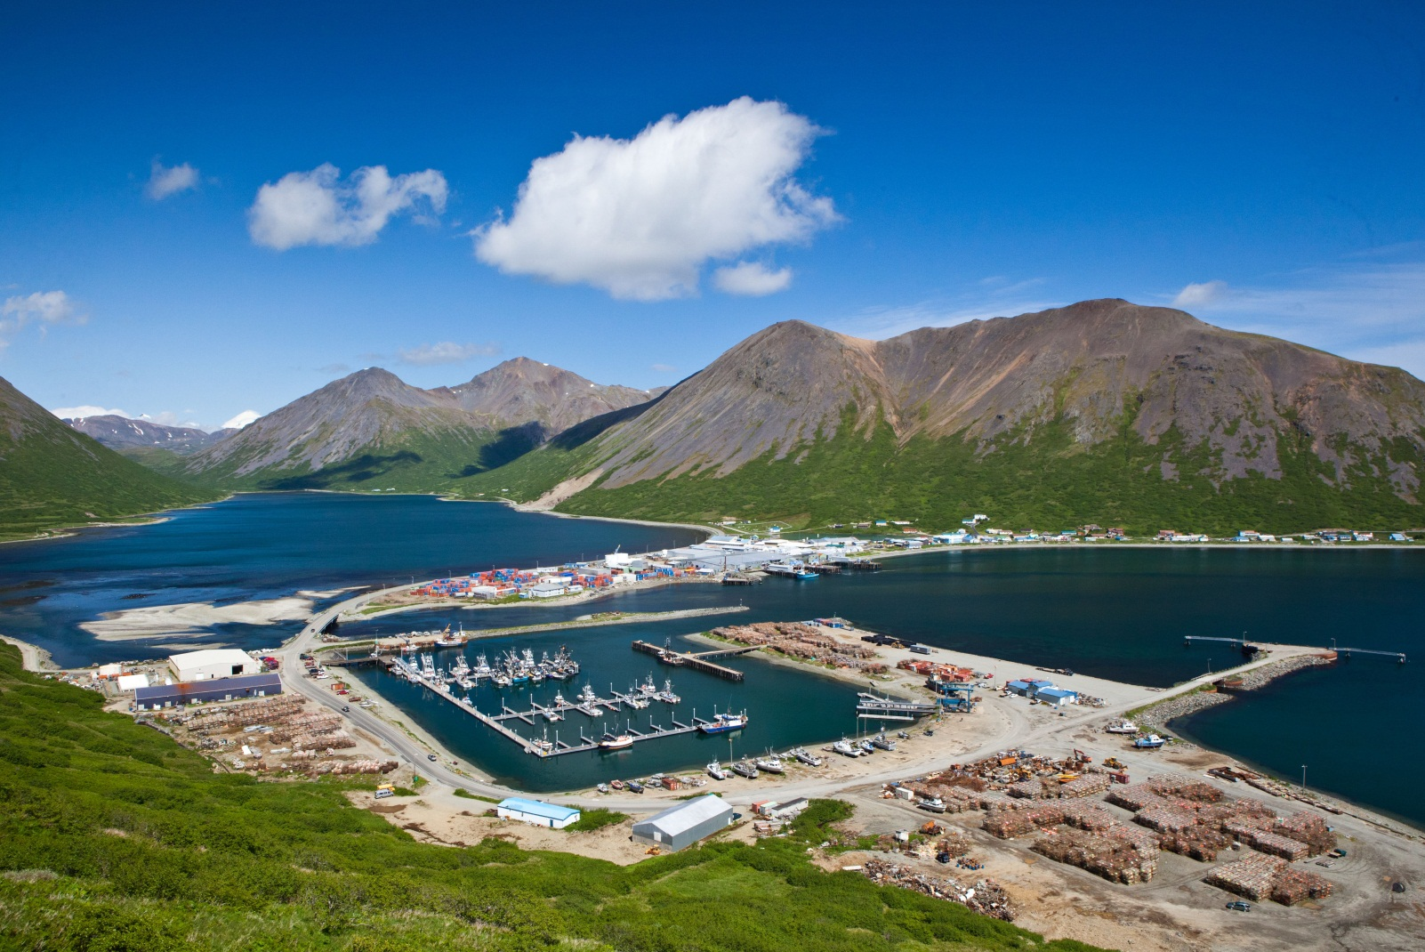
What does the Initiative include?
Basic transportation needs to move from Borough responsibility to private enterprise.

Slide 37
Strategic Initiative C.2: Marine Infrastructure: Cold Bay Dock Repairs
Description:
Cold Bay dock will need major repairs and upgrades before the 10-year life expires.
Project Lead:
One-year Target: Feasibility study completed
Multi-year Goal: Design with cost estimate completed

Slide 38
Why is the Initiative important?
The Cold Bay Dock is owned by the borough.
The Cold Bay Dock is going to fail in the next 8-10 years.
The Cold Bay Dock is the main link for transportation and supplies.

Slide 39
Recent Accomplishments
In January 2021, the Borough issues a Sate of Alaska CAPSIS requesting funds to conduct a Feasibility Study for the construction of new dock in Cold Bay.
Administration identified outcome targets for the reconnaissance/feasibility study.
A document was drafted outlining the work and documents to date.
Administration has drafted the scope of work for the reconnaissance/feasibility study and began writing the Request for Proposal.

Slide 40
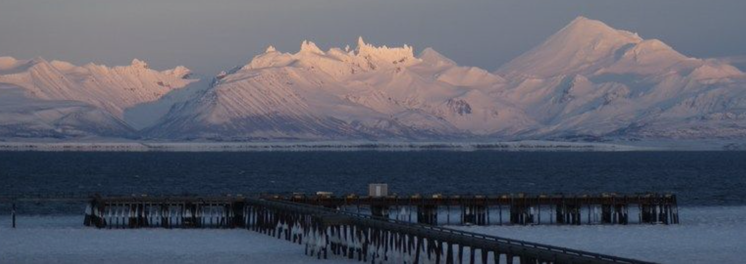
What does the Initiative include?
Execute feasibility study

Slide 41
Strategic Initiative C.3: Sand Point and Akutan Harbor Float Construction
Description:
Build and complete construction of float systems in Akutan and Sand Point.
Project Lead: Anne
One-year Target: Funding obtained for both float systems
Multi-year Goal: Float systems in Akutan and Sand Point constructed

Slide 42
Why is the Initiative important?
It will increase economic activities within the communities.
It will provide additional safe moorage for the fishing fleet.
Complete projects that have been sitting idle for years.

Slide 43
Recent Accomplishments
In February 2021, Administration and Mofatt & Nichol met with MARAD to review the prior Port Infrastructure Development Program (PIDP) Grant application for the Sand Point Akutan Harbor Floats.
Additional Grant opportunities researched.
Funding opportunities for different grant applications were determined.
The Borough hired Mofatt & Nichol to write he PIDP and RAISE grant applications, which were submitted July 29, 2021 and July 12, 2021. Administration submitted the State of Alaska Harbor Facility Grant application on August 12, 2021.

Slide 44
What does the Initiative include?
Hire a grant writer.
Complete and submit grant application.
Secure other funds as needed.
Execute the work necessary to construct the floats.

Slide 45
Strategic Initiative D: Government & Policy Advocacy
Description:
Coordinated effort to influence Borough friendly government action and policy
Project Lead: Alvin
One-year Target: TBD at project planning meeting - Build a strategy to respond to Federal Infrastructure bill

Slide 46
Why is the Initiative important?
Provides guidance to Administration, staff and lobbyist on what to advocate for.
Outlines the State and Federal agenda for the upcoming year.
We need funding on both state and Federal level for the projects we are working on, working with our elected officials on State and Federal level will help guide us through the process with the proper departments.
With the Federal Infrastructure bill in place we need to position ourselves to leverage funds to finish the projects we have on the board.
We also need to have a voice in building the new ferry that will be built to service the Aleutians and the Borough.

Slide 47
Recent Accomplishments
Marine Highway narrative was created.
Administration and the Mayor met with most of the communities to discuss the community's goals/vision; how they were impacted by Covid-19, the fish season and the State budget; what their most critical issues or challenges are and what they hope to accomplish in 2022-2023.
Implemented a mail tracking system to help resolve the mail problem in the region.
Working with Airlines to improve airline service in the region.
The borough is represented on the Alaska Municipal League Board.

Slide 48
What does the Initiative include?
Complete needed white papers.
Our mail discussions need to be moved forward.
Legislative agenda defined State & Federal.
Assess state after election (fiscal climate, potential leadership changes).
Will need to put effort into educating newly elected individuals.

Slide 49
Strategic Initiative E: False Pass Airport
Description:
Establish the False Pass airport as a State of Alaska responsibility and encourage needed improvements
Project Lead: Anne
One-year Target: Have the State of Alaska develop an acceptable project scope and agree to its inclusion in the latest Airport Improvement Program (AIP) Spending Plan

Slide 50
Why is the Initiative important?
The False Pass population has grown beyond the needs of the community.
Planes can’t land when it rains.
The current runway is not suitable for medivac planes.
The community is at risk of losing supply chain access for extended periods of time.
There is a creek running through the runway.

Slide 51
Recent Accomplishments
Completed White Paper on the False Pass Airport in Feb. 2021.
A False Pass Airport Response Plan was created with the goal of having the State of Alaska Develop an acceptance project and agree to its inclusion in the latest Airport Improvement Program Spending Plan.

Slide 52
What does the Initiative include?
Research on current capabilities of the runway and identified needs.
Create a strategy to present to State of Alaska.
Complete False Pass runway white paper.
Assist the city of False Pass and state of AK throughout improvement phase.
Improvements to the False Pass runway.

Slide 53
Strategic Initiative F: Social Infrastructure and Community Well-Being: Cold Bay School
Description:
Demolish the Cold Bay school building property
Project Lead:
One-year Target: Demolition initiated
Two-year Goal: Cold Bay school building is no longer an asset of the Borough

Slide 54
Why is the Initiative important?
The building is vacant and deteriorating rapidly.
The Borough has unsuccessfully attempted to transfer the facility to a third-party multiple times. The Borough will move forward with demolition.

Slide 55
Recent Accomplishments
In March 2021, a letter was sent to Senator Sullivan requesting that he discuss with the different military branches to see if there was interest in the facility.
In March 2021, the Borough issues a Request for Interest/Proposals for the School.
Two responses to the Proposal were received; therefore, Administration pursued transferring the lease and selling the building to a third party.

Slide 56
What does the Initiative include?
Receive direction form the Assembly on how to proceed with this project.

Slide 57
Strategic Initiative G: Borough Property Management – Nelson Lagoon Apartments
Description:
Identify what to do with the Nelson Lagoon teacher housing.
Project Lead: Anne
One-year Target: Remove Nelson Lagoon apartment as a Borough asset

Slide 58
Why is the Initiative important?
The building is vacant and deteriorating rapidly.
Losing revenue insuring a vacant property.
Poses a significant safety liability.

Slide 59
Recent Accomplishments
Options for disposal of the facility were researched.

Slide 60
What does the Initiative include?
Identifying what to do with the property (transfer, repurpose, or demolish).
If a transfer agreement is not in place by June 2021, the Borough will begin looking into demolishing the facility.

Slide 61
Strategic Initiative H: Deferred Maintenance
Description:
Prioritize and manage deferred maintenance for borough owned properties.
Project Lead: Anne
One-year Target: On-going agenda item identifying and completing high priority deferred maintenance projects

Slide 62
Why is the Initiative important?
High number of projects are deferred each year.
Projects need to be completed.
Projects need to be identified and prioritized.
Cost to complete the work increase each year.
Deferred maintenance poses safety risks.

Slide 63
Recent Accomplishments
Funding needs were assessed for this planning Cycle.
Funding was appropriated for the King Cove School repair work and other projects.
The Property Condition Assessment has been partially completed.
The King Cove School repairs have begun but will not be completed unitl spring 2022.

Slide 64
What does the Initiative include?
Identifying all deferred maintenance projects.
Prioritizing projects.
Planning project completion.
Project completion oversight.
Include the King Cove school.
Update Borough inventory.
Develop a deferred maintenance schedule:
Complete assessment of borough buildings outside of the school district.
Include property/equipment other than buildings.
Plan the following year (2022) in advance.

Slide 65
Strategic Initiative I: Sand Point School
Description:
Rehabilitate the existing school building
Project Lead: Talia
One-year Target: This strategy is on hold through 2021 planning cycle
3-year Goal: Funding is secured to execute rehabilitation plan

Slide 66
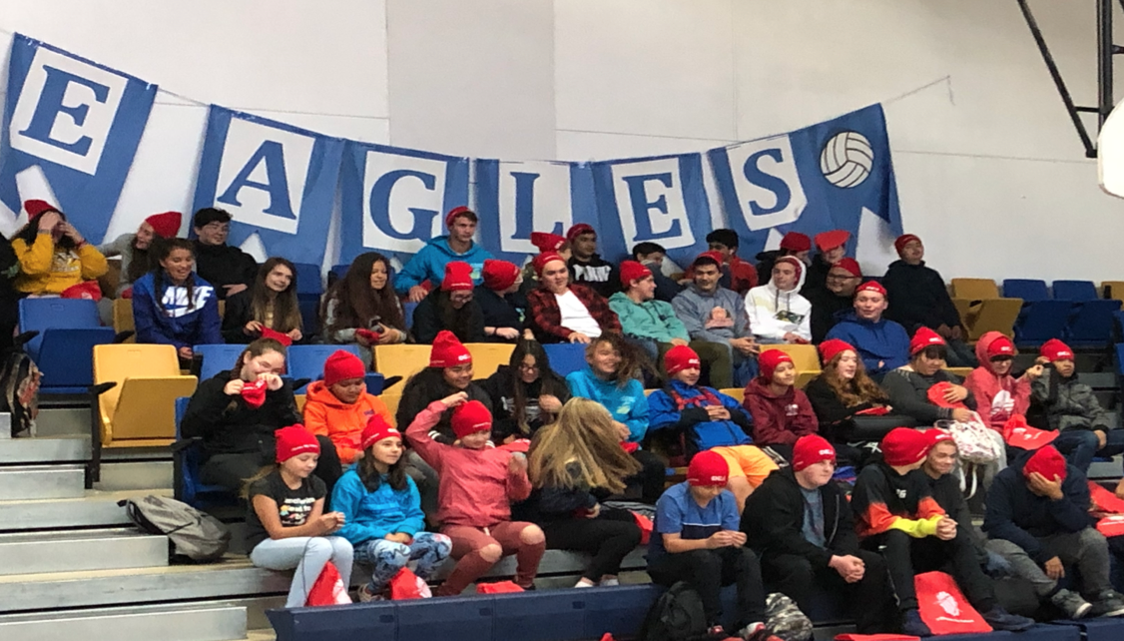
Why is the Initiative important?
Borough priorities are education and facilities.
The Sand Point school structure is deteriorating and needs to be fixed.

Slide 67
Recent Accomplishments
Feedback on the 2020 applications was collected.
Administration reused the scores from the prior year and the letter was submitted to the State.

Slide 68
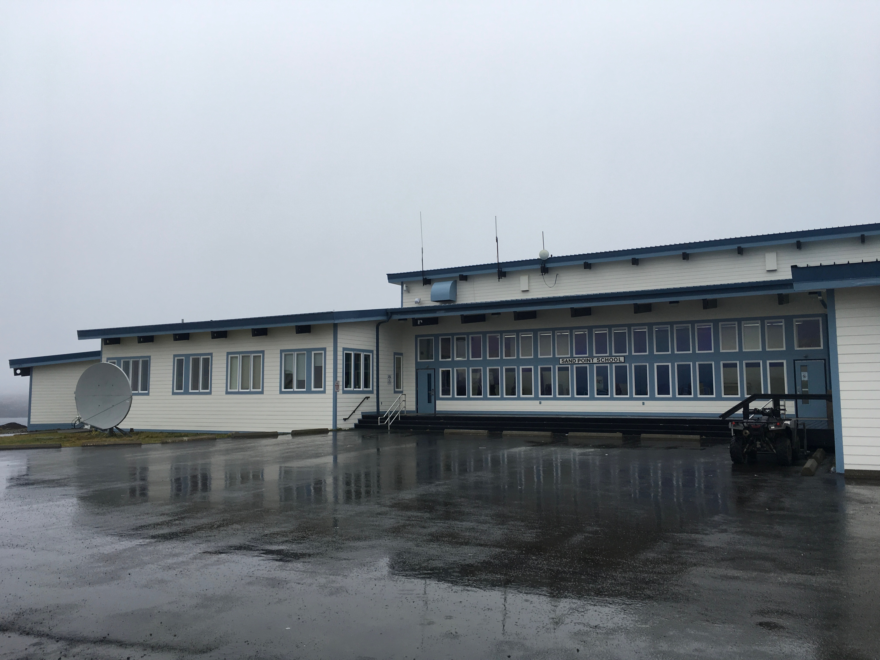
What does the Initiative include?
Determine grant application options.
Secure other funds as needed.
Execute the work necessary to rehabilitate the school.

Slide 69
Component 3: Internal Assessment
Analyze the organization for opportunities to strengthen it and solve problems

Slide 70
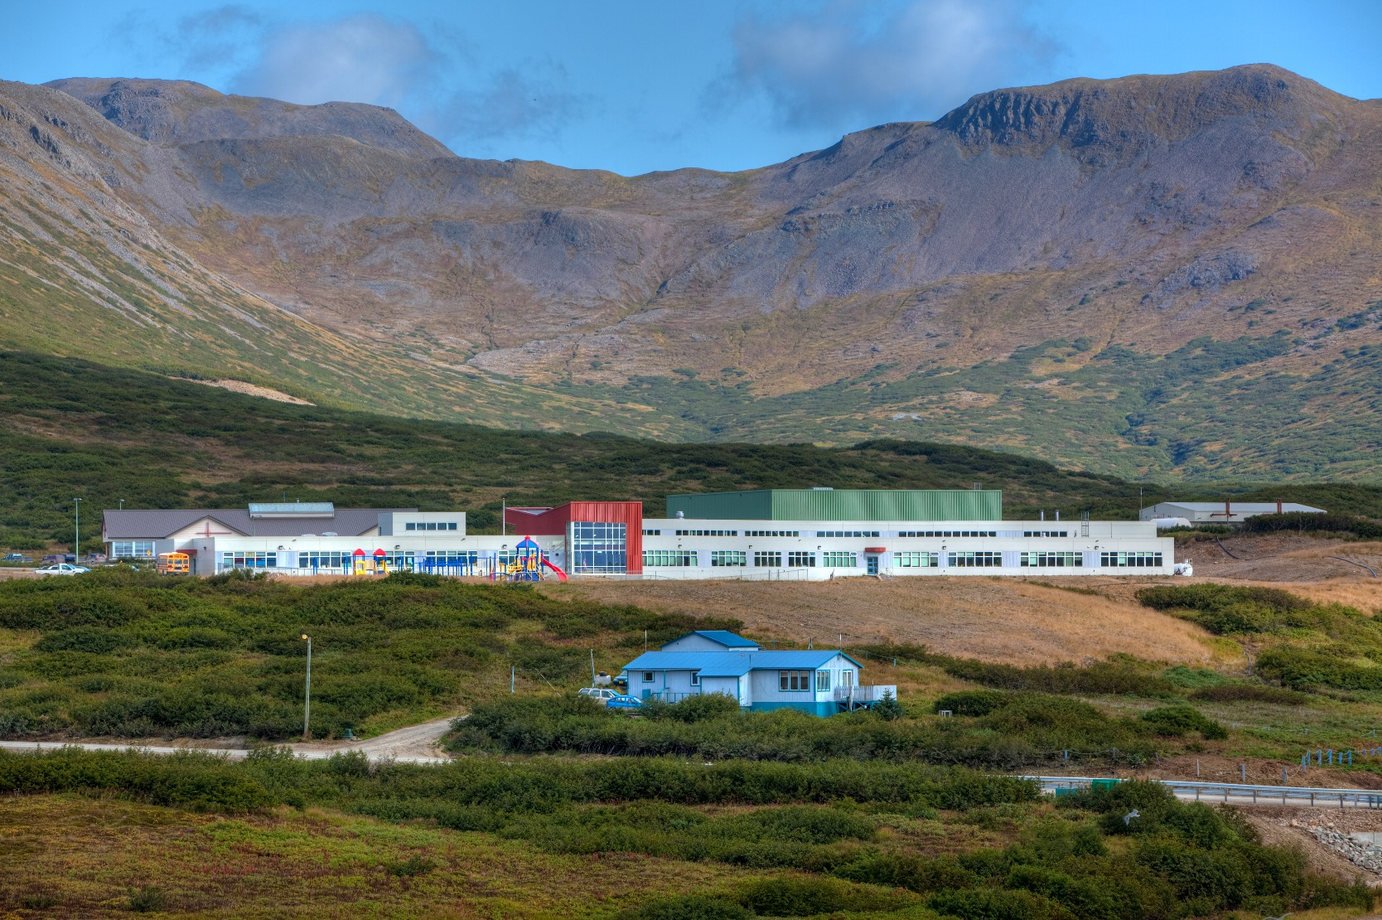
Internal Improvement Projects
The following pages outline the Internal Projects for 2022

Slide 71
Internal Improvement Project 1: PR and Marketing
Description:
Review of the Borough website and assessment of community outreach to improve community engagement and involvement
Project Lead: Laura
One-year Target: Update current AEB public presence

Slide 72
Why is the project important?
Our public presence is a good way to connect with constituents
Photos and updates on our projects in a public forum helps us showcase our accomplishments
To inform residents in the region, our public officials, state and federal lawmakers of the importance of our projects and needed funding to complete them.
We need more public involvement in meetings
Will help with economic development (harbors, airports, fishing, tourism)

Slide 73
Why is the project important?
Connect communities when we can’t travel
To promote grant opportunities (EASE and Civic/Non Profit) and encourage residents to apply for CARES funding.
Promotes transparency.
Need avenues for supporting legislation on the state level like for AMHS, budget cuts, etc.
We need images from the region to develop educational/marketing materials to promote borough interests (e.g. King Cove road)

Slide 74
Recent Accomplishments
AEB website design RFP written-April 2021
Funding needs assessed – May 31, 2021
Website design RFP posted – June 1, 2021
Website design funding allocated – Aug, 31, 2021
Website designer, Planeteria Media, hired - September 2001
Meeting weekly with Planeteria Media to discuss design Sept. 2021 to present
Local Photography/videography plan developed-Nov. 30, 2021

Slide 75
What does the project include?
Issuing an RFQ for a photographer and or videographer
Coming up with a public involvement strategy to get more people involved in Assembly meetings. Are there other ways we can involve people for more transparency?
Figuring out the best way people inform themselves about info in the Borough and expanding on that.
Continue establishing and promoting our Facebook profile as an information and activity center.
Utilize twitter, instagram, to engage in outreach .

Slide 76
Internal Improvement Project 2: Retention Schedule
Description:
Implement a retention schedule for all borough documents/records.
Project Lead: Glennora
One-year Target: Implement a retention schedule for borough documents and records and complete staff training
3-year Goal: Complete implementation of retention schedule (scan necessary records for storage, train all staff, retain necessary hard copy documents)

Slide 77
Why is the project important?
Record keeping.
We can’t keep everything and need to know what we can let go of.
We need to digitize and let go of what we can to save space and increase organization.
Protection of records is critical to managing the borough.
We need are required to retain records for a specific amount of time.

Slide 78
Recent Accomplishments
Drafted Retention Scheduled Completed (by Tina).

Slide 79
What does the project include?
Written policies and procedures.
Comparison of different retention schedule systems and options.
Implementation of the retention schedule plan.
Staff training and compliance.
All records current retained/purged.

Slide 80
Internal Improvement Project 3: Policy and Procedure Consistency
Description:
Audit and review Borough policy and procedures to identify need for improvement, change, or elimination
Project Lead:
One-year Target: Implement identified policy and procedure changes

Slide 81
Why is the Initiative important?
Create consistency in the organization.
Eliminate redundancy.
Minimize confusion.
Improve administrative function and efficiency.
Create a record for future borough leaders and administration.
Transparency and promoting public trust.

Slide 82
Recent Accomplishments
Employee and Borough policies and procedures have been inventoried.
New policies and procedures have been identified.
Needed changes have been identified and policies and procedures changes have been prioritized.
Have implemented the following policies and procedures:
Business Travel Policy
Permanent Fund Earning Policy
Journal Entry and Bank Reconciliation Policy
Borough Owned Equipment Usage Policy

Slide 83
What does the Initiative include?
Implement changes systematically.
Update the employee handbook, when needed.
Create internal policies that would be included in a universal location.
Get assembly approval where needed.

Slide 84
Internal Improvement Project 4: Borough Property Maintenance Policy and Procedure
Description:
To determine roles and responsibilities as well as improve project planning and collaboration
Project Lead: Anne
One-year Target: Implement Borough long-term maintenance management process

Slide 85
Why is the Initiative important?
Clarified roles will promote efficiency.
Duplication of work.
Role clarity causes work to be left undone.
Long-term cost of inefficiency.
Improve budgeting and planning process.

Slide 86
Recent Accomplishments
Assessed the school maintenance process.

Slide 87
What does the Initiative include?
Expand focus outside of the school district to all borough buildings.
Collaborate with the school board to establish contribution and agree on an execution plan.
Align Borough maintenance plan with the School District 6-year plan
Training of School District Personnel
Consistency in reporting procedures
Implementation of a training program
Better record keeping
Adhere to any agreements that have been agreed upon

Slide 88
Internal Improvement Project 5: Financial Policies and Procedures
Description:
Audit, review, and document all financial policies, procedures and processes.
Project Lead: Anne
One-year Target: Create and Implement needed finance policies and procedures

Slide 89
Why is the Initiative important?
There are unknown policies, procedures, cycles etc.
We do not have documented policies, procedures, or processes.
Improve administrative function and efficiency.
Create a record for future borough employees.
Transparency and promoting public trust.
To create a tool for cross training.

Slide 90
Recent Accomplishments
Complied a list of all duties and processes from the job descriptions of both the finance director and the accounting clerk.
Processes then organized by timeline, capturing processes that happen weekly, bi-weekly, monthly, quarterly, and yearly.
Complied by 9 major sections included in a typical financial policy and procedure manual.
Prioritized the policy needs to complete over the next two years.

Slide 91
What does the Initiative include?
Select number of policies to be written/implemented - target 4
Identify policy and procedure needs.
Draft policies and procedures.
Formal approval/policy review where needed.
Staff policy and procedure training protocols in place.
Policy effectiveness assessed.
Policy review and change process created.
Policy and procedure shared drive or access point for staff and assembly.

Slide 92
Internal Improvement Project 6: Community & Agency Alignment
Description:
Improve overall alignment with communities and agencies within the Aleutian East Borough
Project Lead: Glennora
One-year Target: To design and initiate an alignment effort

Slide 93
Why is the Initiative important?
The 2020 Internal assessment identified a need to improve alignment with communities and organizations.
The Borough needs to identify ways to have an increased physical presence in the communities they serve.
Ensure we have updated leadership contact information and remain engaged with community leaders through transitions.

Slide 94
Recent Accomplishments
On the agenda distribution emailing list for each community.

Slide 95
What does the Initiative include?
Utilize existing platforms to increase community connectivity (Youtube Channel, Website, Facebook).
Explore ways to engage and align with communities in the way that would work best for each community.
Complete an assessment to learn about each community interest/need.
Find ways to highlight community leaders and engage community members in presenting and addressing community issues, concerns, and accomplishments.
Improve general knowledge and awareness between each community and the Borough.

